Slide 1
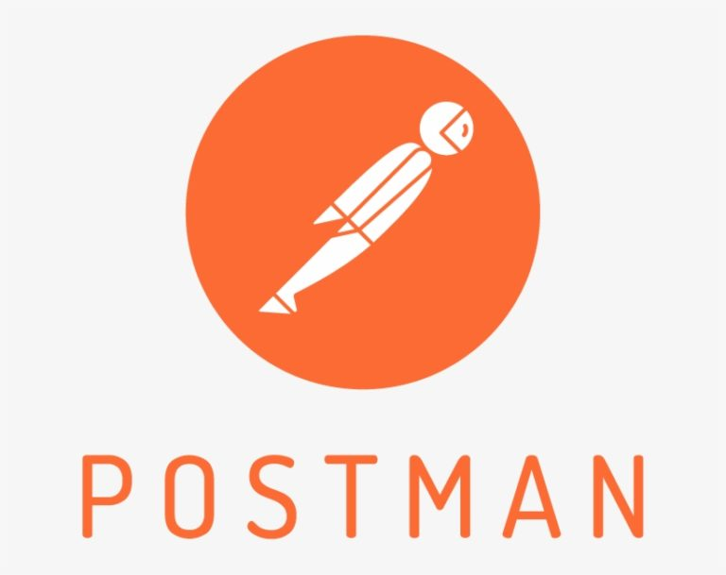
Gyorgy Papp & Francisco Bejarano
Notes:
Welcome to the world of Postman, a revolutionary API development and testing tool. In the next few minutes, we'll explore how Postman simplifies the complex landscape of API workflows. From crafting requests to automated testing and collaboration, Postman empowers developers, testers, and businesses worldwide. Let's uncover the key features and benefits that make Postman an indispensable asset in modern software development

Slide 2

Exploring the Power of Postman
Postman is an API Development and Testing Tool:
Postman is a widely-used platform designed for API development and testing.
Key Functions of Postman:
Facilitates the creation and execution of API requests.
Supports automated testing, collaboration, and integration with CI/CD pipelines.
Users of Postman:
Utilized by developers, testers, and businesses globally.
Over 11 million developers and 500,000 companies, including major entities like Microsoft and Twitter.
Widely adopted by Fortune 500 companies, with 98% of them reported to use the platform.
Notes:
Postman is a widely-used platform designed for API development and testing. It facilitates the creation and execution of API requests, supports automated testing, collaboration, and integration with CI/CD pipelines. Postman is utilized by developers, testers, and businesses globally, with over 11 million developers and 500,000 companies, including major entities like Microsoft and Twitter. It is widely adopted by Fortune 500 companies, with 98% of them reported to use the platform.

Slide 3

Evolution of Postman
Started as a side project in 2012 by Abhinav Asthana
He found it difficult to test APIs so he decided to make his’s own tools
It started as a Chrome extension but as it rapidly gained popularity it became a standalone application.
Through continuous updates and improvements, today it is industry standard
Notes:
Postman Founder and CEO, Abhinav Asthana, traces his entrepreneurial journey from experiencing his first computer in Basti, UP, to founding Postman, a SaaS startup. Raised in various towns due to his father's transferable job, Abhinav's early exposure to programming led to his first paycheque from website design. In 2012, he initiated Postman to address API debugging challenges, formalizing it in 2014. The platform, aiding software developers in collaboration, recently raised $150 million, achieving a $2 billion valuation. Originally a side project, Postman rapidly gained popularity and is now used by over 11 million developers globally, including major companies. Abhinav emphasizes the power of community engagement, transparency, and continuous product improvement. APIs, crucial in modern software, contribute significantly to global infrastructure service providers' revenue. Despite the pandemic, Postman has grown, hired aggressively, and maintained its commitment to building a top technology company from India, proving that great products can originate from the country.

Slide 4

Efficient API Testing
1. Create and organize requests in collections.
1
2. Define request parameters, headers, and authentication.
2
3. Execute requests and examine responses.
3
4. Utilize test scripts for automated validation.
4
Notes:
These steps outline a typical workflow in Postman for API development and testing: users begin by creating collections to organize related API requests. For each request, they define parameters, headers, and authentication settings. Requests are then executed, and the responses are examined using Postman's interface. To automate validation, users can employ test scripts, usually written in JavaScript, to ensure API functionality and meet specified criteria. This workflow allows for systematic and efficient API development and testing.

Slide 5
Diving into Requests
GET: Retrieve data
POST: Send data
PUT/PATCH: Update data
DELETE: Remove data
HEAD: Retrieve data without response body
OPTIONS: Communication options
Notes:
GET requests are used to retrieve data from a server. When you make a GET request, you are asking the server to provide information, and the response typically includes the requested data.
POST requests are used to submit data to a server for processing. It is commonly used when you want to create a new resource on the server, such as submitting a form or uploading a file.
PUT requests are used to update a resource on the server. If the resource doesn't exist, PUT can create it. When making a PUT request, you usually send the entire representation of the resource in the request.
PATCH requests are used to apply partial modifications to a resource. Instead of sending the complete representation of the resource, you only send the changes you want to apply.
DELETE requests are used to request the removal of a resource from the server. It signifies that you want to delete the specified resource, and the server should perform the deletion.
HEAD requests are similar to GET requests, but they do not include the response body. They are useful when you're interested in retrieving meta-information about a resource without actually getting the resource's representation.
OPTIONS requests are used to describe the communication options for the target resource. The response provides information about the supported methods and other capabilities.

Slide 6

Integrating with CI/CD pipelines
Postman CLI | Newman
Created by Postman | Created by Postman
Maintained and supported by Postman | Open source; supported by community contributions
Supports collection runs | Supports collection runs
Automatically sends collection run results to Postman by default | Supports ingesting run results to Postman using a reporter
Package is signed by Postman | Package isn't signed by Postman
Distributed as a downloadable package | Distributed on npm
Downloadable programmatically | Downloadable programmatically
Not available as a library | Available as a library
Supports sign in and sign out | Doesn't support sign in and sign out
Checks API definition against configured API Governance and API Security rules | Doesn't check API definition against configured API Governance and API Security rules
Notes:
It is possible to automate collection runs in a CI/CD with the Postman CLI or Newman.
Postman CLI is developed and maintained by Postman, while Newman, though created by Postman, is open source and supported by community contributions. Both tools support collection runs, but Postman CLI automatically sends results to Postman, whereas Newman supports result ingestion using a reporter. Postman CLI's package is signed by Postman and is distributed as a downloadable package, while Newman's package is unsigned and distributed on npm. Postman CLI supports sign-in and sign-out and checks API definitions against configured API Governance and Security rules. On the other hand, Newman doesn't support sign-in or sign-out and doesn't check API definitions against configured rules. Additionally, Postman CLI is not available as a library, whereas Newman is available as one. Some Postman CLI commands use the Postman API to fetch data from and send data to Postman's servers. These commands count toward the monthly Postman API usage. The number of Postman API calls that can be made each month depends on the Postman plan agreed.

Slide 7
Benefits of Postman
Time Efficiency:
Automates Testing
Batch Processing
Consistency and Reliability:
Consistent Testing
Reproducibility
Continuous Integration and Deployment Support:
Integration with CI/CD Pipelines
Automated Deployment
Enhanced Collaborations:
Shared Collections
Version Control
Notes:
Automating tasks in Postman offers significant advantages in API development and testing. Firstly, it enhances time efficiency by automating testing processes, reducing the time and effort required for repetitive tasks. Additionally, the ability to execute multiple requests simultaneously through batch processing further contributes to time savings. Secondly, automation ensures consistency and reliability in testing by executing tests in a standardized manner, minimizing human errors, and promoting reproducibility of workflows. Thirdly, Postman's automation capabilities seamlessly integrate with continuous integration and deployment (CI/CD) pipelines, allowing for continuous testing throughout the development lifecycle and automated testing as part of the deployment process. Lastly, automation in Postman fosters enhanced collaboration within teams through shared collections, enabling multiple team members to work with the same set of tests, and supporting version control for collections to track changes and revert to previous versions if needed. Overall, these benefits contribute to a more streamlined and effective API development and testing process.

